Slide 1
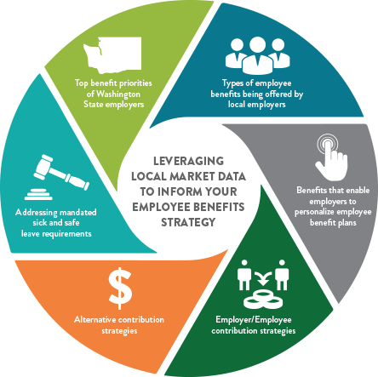
COMPREHENSIVE EMPLOYEE BENEFITS REPORT
In today’s competitive talent marketplace, it is imperative for organizations to make informed and strategic decisions regarding their employee benefits strategy.
Get complete details and claim your COMPLIMENTARY* Comprehensive Employee Benefits Report by participating in the online survey no later than Friday, September 29th by visiting WaStateCouncil.SHRM.org/BenefitsSurvey.
*To get a complimentary report you must be a current SHRM member and have designated a local Washington State SHRM Affiliate Chapter.

