Slide 1
Joyce Allen
RTW Incentives Outreach
(360) 902-4978/Joyce.Allen@Lni.wa.gov

Slide 2
Return to Work Program
What is a Return to Work Program?
A written, proactive process designed to assist employers return injured or ill employees to medically approved productive work.

Slide 3
Return to Work Program
What is included?
Written Policy Statement
Signed by President/CEO/Management
Written Procedures
Who, What, When, Where, Why & How
Ongoing Education
Eliminates surprises and misunderstanding
Communication

Slide 4
Stay at Work Program
Employer’s Job Description
Employer & Worker Information
Essential Task Duties
Physical Demands
Attending Healthcare
Provider Approval

Slide 5
What is the
Stay at Work Program?
A legislatively mandated (EHB 2123) program providing financial incentives for State Fund Employers providing light duty or transitional work to employees recovering from on-the-job injuries.
RCW: 51.32.090
WAC: 296-16A

Slide 6
Stay at Work Program
Reimbursements – Per Claim
Wages
Training
Tools/Equipment
Clothing

Slide 7
Stay at Work Program
Wage Reimbursement
Pays
50% of base wage
Excluding tips, commissions, bonuses, board, housing, fuel, health care, dental care, vision care, per diem, reimbursement for work-related expenses or any other payments.
Includes shift differential and overtime.
For
Up to 66 days actually worked (not necessarily consecutive)
Up to $10,000 (whichever comes first.)
24-month period per claim
And
Employer has 1 year to apply from first day of light duty or transitional work.
Reimbursements are per claim.

Slide 8
Stay at Work Program
Training Reimbursement - $1,000
For training necessary for the light duty or transitional work
Tuition
Books
Fees
Other necessary materials

Slide 9
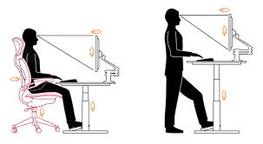
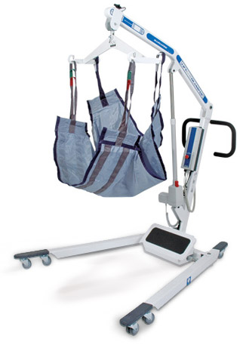
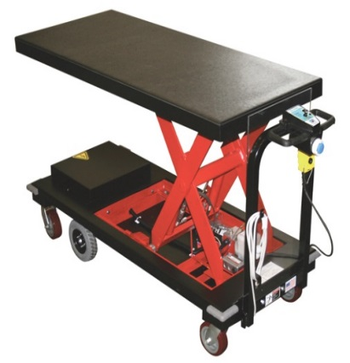
Stay at Work Program
Tool & Equipment - $2,500
Tools and equipment become the property of the employer

Slide 10
Stay at Work Program
Clothing - $400
Becomes property of the worker

Slide 11
Visit our website at:
www.Lni.wa.gov/Stayatwork
E-mail the Stay at Work Unit at: stayatwork@lni.wa.gov
Call the Stay at Work Unit at:
1-(866) 406-2482 or (360) 902-4411

Slide 12
What is the Preferred Worker Program?
The Preferred Worker Program is one of L&I’s return-to-work incentive programs.

Slide 13
Preferred Worker Program
What is a Preferred Worker?
A worker with a permanent medical restriction may be certified as a “preferred worker”
This certification enables an employer to receive fi financial incentives when they hire the a worker for a medically-approved, long-term job
Notes:
Someone who’s been injured on the job and now has a permanent impairment because of that work related injury.
*
LNI’s trying to create a bridge between a worker with permanent impairments and perspective employers

Slide 14
Preferred Worker Program
Who can be certified as a Preferred Worker?
To be considered eligible, a worker:
Must have an open STATE FUND IN SURED CLAIM that results in a permanent disability which may be a substantial obstacle to employment.
Must have a physical or mental condition caused by an industrial injury or occupational disease in which
No further curative treatment is planned OR
The worker is at or near maximum medical improvement
Notes:
The certification is attached to the worker and financial incentive is given to the employer that hires them.
How does a worker become a certified Preferred Worker?
*
Has to have an open State Fund claim resulting in a permanent disability.
*
They must have a physical (or mental) condition caused by an on-the-job injury or occ dis which is resolved
What does that look like?
No further curative treatment planned
The worker is at or near mmi

Slide 15
Preferred Worker Program
Permanent Disability is defined as:
A permanent loss of physical or mental function, caused by the industrial injury or occupational disease from which, within the limits of medical probability, further recovery is not expected; and
The worker’s healthcare provider has permanently restricted the injured worker from returning to the job-of-injury; and
The work restrictions are supported by medical findings appropriate to the worker’s physical or mental condition.
Notes:
What we find is a stigma against people who file LNI claim’s especially when someone has a perm dis resulting from a claim.
We realize someone may have a perm disability but they’re not broken. They still have skills that an employer can find useful.
*
How does LNI define a disability?
Perm loss of function (physical or mental)
The medical needs to support recovery is not expected
*
A health care provider must restrict the worker from JOI
*

Slide 16
Preferred Worker Program
What is a Substantial Obstacle to Employment?
The Worker may be:
Unable to perform at least one (1) essential function of the job of injury or
Eligible for vocational retraining or
Permanently restricted to a lighter category of p of physical work demands
An example of a lighter category of work
Job of injury = Heavy work, now restricted to sedentary work
Notes:
Get some of Steve’s examples:

Slide 17
Preferred Worker Program
Who can certify a preferred worker?
Only a department employee with authority to do so may certify a worker as a preferred worker.
Notes:
The Department determines who will receive certification. A vocational counselor, a TPA staff member or a retro group can not make that determination.

Slide 18
Preferred Worker Program
Who decides that the job meets the preferred worker’s medical restrictions?
The employer is only eligible for preferred worker benefits when the offered job is approved by:
A credentialed vocational rehabilitation professional, and
The injured worker’s health care provider, which could be:
The attending provider
The currently primary care provider, or
In cases of mental health condition, the treating psychiatrist or psychiatric advanced registered nurse practitioner or treating psychologist.
Notes:
It takes a dept voc counselor along with a health care provider to determine if the job meets the restrictions.

Slide 19
Preferred Worker Program
How long does Preferred Worker Certification last?
A preferred worker’s certification will last
Thirty six ( 36) consecutive months
The benefit start date begins the first day after the department has received the Preferred Worker Request form with all the required documentation from the 1st Employer
Ends no later than five (5) years after claim closure
If Thirty six (36) months has ended, worker may be eligible for “preferred worker” certification under a subsequent claim.
Notes:
Once the dept has recvd all of the required doc the benefit start date begins.
*
Certification Expires no later than 5 years after claim closure. The next slide illustrates this…

Slide 20
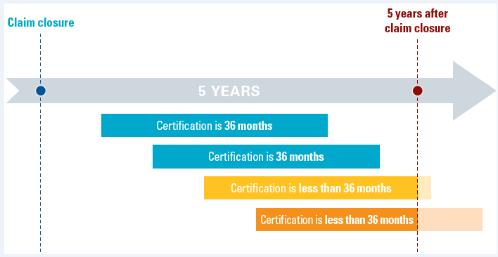
Preferred Worker Program
How long does the Preferred Worker Certification last?

Slide 21
Preferred Worker Program
Which employers are eligible to benefit from the Preferred Worker Program?
The following employers may be eligible to benefit from the preferred worker program if they employ a certified preferred worker in a job approved by the injured worker’s health care provider and L&I’s credentialed vocational rehabilitation professional:
A Washington Sta te Fund employer with an industrial insurance account in good standing with L&I, as outlined in Chapter 296-17-31004(4) WAC; or
A self-insured employs a worker who is certified as a preferred worker under a State Fund claim.
Notes:
State fund – in good standing – not owing us any money for any program

Slide 22
Preferred Worker Program
What must an employer do to qualify for benefits when hiring or reemploying a preferred worker?
An Employer must employ the certified preferred worker in a job that:
will continue to be available into the foreseeable future, and
is confirmed as consistent with the worker’s permanent work restrictions as outlined in WAC 296-16-145, and
addresses a business need or provides economic value to the employer.
Notes:
Meets the worker’s perm restrictions

Slide 23
Preferred Worker Program
Employer Benefits – Financial Protection
If you employ a preferred worker who is injured on the job or diagnosed with an occupational disease during the preferred worker certification period, L&I will pay the costs of the new claim with no direct cost or penalty to you.
Notes:
pwp provides financial protection to an employer hiring a preferred work in that any newly filed claim in not affect the employers rates, during the certif period
This is not a new incentive – this is part of the original benefit of the pwp program.

Slide 24
Preferred Worker Program
Employer Benefits – Financial Protection
If you are a State Fund employer, the costs for the new claim will not be charged against your account, and the new claim will not affect your experience rating.
If you are a self-insured employer, you may ask L&I to reimburse you for the claim costs when the claim is ready for closure.
Notes:
This is how it works…
The cost of a new state fund claim would be charged against the 2nd injury fund.

Slide 25
Preferred Worker Program
Employer Benefits – Premium Relief
If you are a State Fund Employer:
No charges for Accident Fund or Medical Aid Fund Premiums.
Only Supplemental Pension Fund premiums need to be paid.
The hours worked by the preferred worker must be reported in the risk class 7204.
Notes:
When you hire a pref worker, risk class 7204 will be added to your LNI account – this is the risk class you’ll report the hours worked by your pref worker.

Slide 26
Preferred Worker Program
Employer Benefits – Premium Relief
If you are a self-insured employer:
Once reimbursed by L&I, you may deduct the amount of preferred worker claim cost reimbursements on your next self-insured quarterly report.
Supplemental pension and asbestos assessments need to be paid.

Slide 27
Preferred Worker Program
Employer Benefits: enhanced for workers certified on or after 1/1/2016
The expanded preferred worker incentives are available to an eligible employer who hires a worker who was certified on or after January 1, 2016.
Notes:
We outlined what hasn’t changed with the program we’ve enhanced the program effect 1/1/16
So now lets go over the newly added benefits

Slide 28
Preferred Worker Program
Employer Benefits - enhanced
Eligible Employers may be reimbursed (for)
50% of basic gross wages for work performed in a new or modified medically-approved job.
Reimbursements are paid on wages up to 66 days within 24 month period, not to exceed $10,000
Basic gross wages do not include:
Tips, commissions, or bonuses
Board or housing
Fuel, per diem, and/or other work related expenses
Health, dental or vision care
Any other payments to the injured worker

Slide 29
Preferred Worker Program
Employer Benefits - enhanced
Eligible Employers may be reimbursed (for)
Up to $2,500 for equipment & tools
Examples: special wrench, one-handed keyboard, rolling cart or bag, anti-vibration tool wrap, light-weight ladders, or text magnifiers
The Department will not reimburse for equipment & tools that the employer would normally supply its workforce.
To be reimbursed, you need to purchase the equipment & tools:
After you offer the worker the job and
No earlier than 60 days before the first date of the preferred worker’s employment.
Equipment & tools become the property of the employer

Slide 30
Preferred Worker Program
Employer Benefits - enhanced
Eligible Employers may be reimbursed (for)
Clothing – up to $400 per claim
Examples: steel-toes boots, anti-vibration gloves, heated coat, or office-appropriate attire.
The Department will not reimburse for uniforms or clothing provided to the worker that the employer would normally supply its workforce.
The clothing becomes the property of the preferred worker.

Slide 31
Preferred Worker Program
Employer Benefits - enhanced
“Continuous Employment” incentive
Employer continuously employs worker for 12 consecutive months without a reduction in base wages
Maintains same work pattern as medically approved job
12 months begin the date the worker is certified as a preferred worker or the first date of employment, whichever is later
Notes:
Pwp is building the bridges to hep workers find emplymnt – to help them sustain the employment we’ve created the continuous emplyment bonus

Slide 32
Preferred Worker Program
Employer Benefits - enhanced
“One Time Payment”: The LESSER amount
10% of workers wages (OR)
$10,000
All documentation must be submitted within one (1) year of the date the 12 months ended.

Slide 33
Preferred Worker Program - Success Story
Notes:
We’d love to share a video to illustrate a great success story – using PWP

Slide 34
Preferred Worker Program
When do the benefits start and end?
Benefits can start the worker’s first workday after ALL the required completed paperwork is received by L&I, and can last:
Throughout the preferred worker’s certification period or
Until the preferred worker leaves your employment, whichever comes first.
Notes:
we’ve already stated it’s the first day after all documents are received:
- Benefits continue until the certif period ends or the worker leaves your employment

Slide 35
Preferred Worker Program
The employer will not be eligible for preferred worker incentives if the offered job is:
The job of injury with minor or no modification.
Work that is beyond the worker’s medical restrictions.
Work that requires training beyond the usual and customary training provided by the employer to similar employees.
On-the-job training.

Slide 36
Preferred Worker Program
How to apply for PWP Reimbursements
Make sure your account is active & in good standing with the Department
For State Fund employers, this means you are current on your premiums or the payments required under an approved payment plan.
Notes:
First of all, ensure you’re in good standing

Slide 37
Preferred Worker Program
How to apply for PWP Reimbursements
Develop a job that:
Meets the worker’s permanent work restrictions
Addresses a business need or provides economic value to you as an employer
Will continue to be available into the foreseeable future
Notes:
Create and a permanent position that meets the workers perm restrictions

Slide 38
Preferred Worker Program
How to apply for PWP Reimbursements
Complete a job analysis or employer’s job description which:
Specifies the physical requirements of the proposed job and
Send it to the worker’s health care provider for review, with a copy to the worker.
Notes:
Place the job details on a JA or a JD form

Slide 39
Preferred Worker Program
How to apply for PWP Reimbursements
After the provider approves the job:
Offer the job to the worker in writing and
Have the worker sign it to indicate their acceptance

Slide 40
Preferred Worker Program
How to apply for PWP Reimbursements
Complete Part B of the Preferred Worker Request Form and attach the required documents:
Preferred Worker Request Form, signed by the employer
Job Analysis or the Department’s Employer’s Job Description form for the preferred worker job with the medical provider’s signature that the tasks and duties needed to perform the job are within the medical restrictions of the injured or ill worker.
Job offer, signed by the worker
Part B - Preferred Worker Application Process

Slide 41
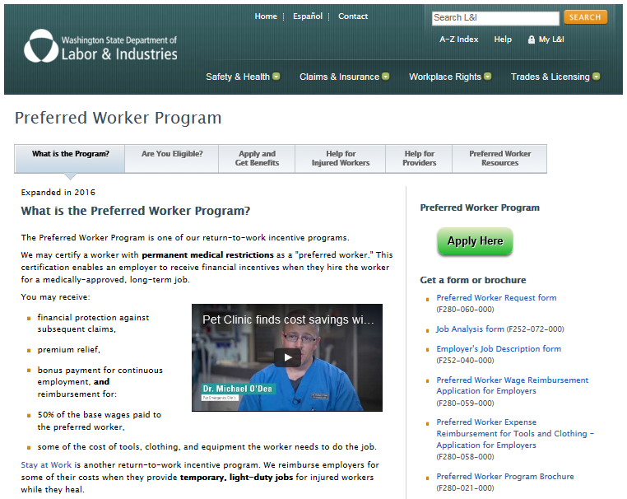
Preferred Worker Program
How to apply for PWP reimbursements

Slide 42
Preferred Worker Program
What documents are required for the PWP Reimbursements?
A copy of the completed job analysis or L&I’s job description form, approved by the worker’s health care provider, Certified Vocational Professional, and
The job offer, signed by the worker, and
L&I’s Preferred Worker Request Form, available on L&I’s website, completed and signed by the employer.

Slide 43
Visit our website at:
www.Lni.wa.gov/PreferredWorker
E-mail: PrefWorkerProg@Lni.wa.gov
Call the Preferred Worker Unit at:
1-(800) 845-2634

Slide 44
Return to Work Partnerships Outreach Staff
Call or E-mail:
Amanda Fisher
Return to Work Partnerships Operations Manager
fiam235@lni.wa.gov 360.902.6153
Christopher Ver Eecke, M.Ed, CRC, CCM, CDMS
verc235@lni.wa.gov 360.902.4419
Joyce Allen
alls235@lni.wa.gov 360.902.4978
Tuyen Manikhoth
phat235@lni.wa.gov 360.902.5875
Robbie Rotz
rotz235@lni.wa.gov 360.647.7319

