Slide 1
Our Ageing Workforce
Amy Solis
Sr. Human Resources Analyst for Training & Employee Development
Thurston County Human Resources

Slide 2
What We’ll Cover
What do the numbers tell us?
Issues and concerns in the workplace
Myths vs. facts
Strategies for keeping aging workers employed and engaged
Team table solution – What would you do?

Slide 3
Check out these numbers
77 million baby boomers
30.8 million in the workforce
85% plan to continue working after retirement
70% prefer to work full time
65% plan on working past age 65
10,000 baby boomers are reaching retirement age every day

Slide 4
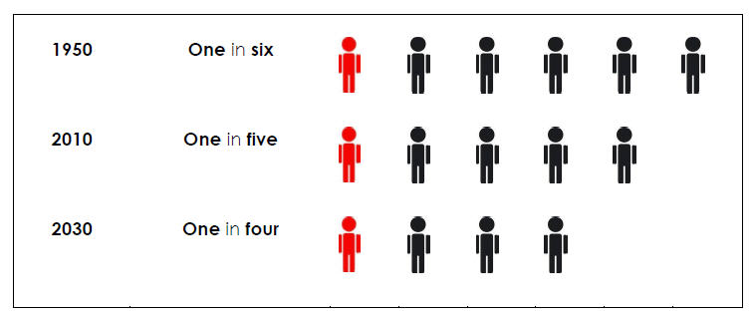
Workers over age 55 in the Labor Force as a Proportion of all workers, projected1950 to 2030
Sources: Bureau of Labor Statistics, “Labor Force Projections to 2018: Older Workers Staying More Active,” Monthly Labor Review, November 2009; Bureau of Labor Statistics, “New Look at Long-term Labor Force Projections to 2050,” Monthly Labor Review, November 2006.

Slide 5
Why is the workforce aging?
Increased longevity and function
Declining pool of younger workers
Enjoy working and being productive
Delayed retirement due to financial need
Insufficient retirement savings
Health care costs
Need to support other family members
Lack of confidence in finances

Slide 6
Health/Safety
Higher incidence certain chronic illness/disease
Inform Participants – Health concerns at all levels
Focus on prevention – EAP, Wellness Programs, Team Challenge
Modify work to respond to issues with aging
Ergonomic initiatives
Accessibility to tools and equipment
Hydraulic lifts and power tools
Partner with co-worker for physically challenging work
Notes:
Participant surveys
Nurse line
Increase cost un blended plans
Office computer screens
Chairs
Manhole covers because of girth
Higher values to reduce amount of stooping
Safety glasses with magnifiers
SCR elevator levels reduce need to carry 50lb wrench
Strains, Sprains, Trip, slip and falls
Energy Supply reduces incidences from 20 in 2005 to 8 in 2006
Also increase in employee involvement

Slide 7
Knowledge Transfer
Utilize the expertise within
Peer coaching
Peer mentoring
Staff involvement in learning
Policy review
LEAN process with all employee levels
Job rotation as a form of development and recognition
Notes:
CSPs get to leave call center because of high performance

Slide 8
Why do so many claim Social Security early
Early retirement
Can’t afford to wait
Spousal or child benefit
Health concerns
Notes:
Average age is 62 (filing can be done between 62 and 70)
42% men
48% women
Normal retirement age is 66-67 (full retirement age)

Slide 9
Issues and Concerns in the Workplace
Likely increase for accommodations, but will result in retention of valuable, experienced and strong individuals
Age discrimination claims are the fastest growing category of discrimination cases nationwide
Recognition of the importance of workplace culture, job responsibilities, and employee engagement
Teamwork
On the job mentoring

Slide 10
What Aging Workers Want?
Viable work options and meaningful employment
Respect for abilities and experience
Inclusion rather than tokenism
Equal access to skill acquisition
Equity in mobility and promotions
Reasonable accommodations
Flexible work schedules

Slide 11
Myths vs. Facts
Long-standing myths:
Technologically is difficult for them
Slow to learn new skills
Lack creativity and ability to change
Perform at lower and slower level
Less motivated to go beyond what’s expected
Less flexible and adaptable
Costs – higher pay, medical insurance

Slide 12
Facts:
Low turnover rate
Commitment to quality
Good attendance and punctuality
Few on-the-job accidents
High motivation and engagement
Strong work ethic and experience
Loyalty and reliability
Availability to work a variety of schedules

Slide 13
Strategies for Keeping Aging Workers Employed
Workplace flexibility: work from home, work from more than a single location, snowbird programs
Work hour flexibility: part time employment, job sharing
Career flexibility: on/off ramps, leaves, reduced responsibilities, job changes
Benefit flexibility: phased retirement, cafeteria plans
Flexibility in employment relationships: project work, consultation, independent contracts
Training to upgrade skills for current or new job
Provision of reasonable accommodations

Slide 14
Does Working Longer Lead to Healthier and Happier People?
Maintaining identity and sense of purpose
Sustaining productive engagement
Physically demanding jobs and their contribution to physical health for those 65 and over
Social interaction and connectivity
Value of job related rewards
Source: Center for Retirement Research at Boston College
Notes:
Positive physical and psychological effects due to:

Slide 15
Team Table Solution – What would you do?

Slide 16
Thank You for your participation.
Amy Solis
Sr. HR Analyst for Training & Employee Development
Thurston County Human Resources
solisa@co.thurston.wa.us
360/786-5498 ext. 7302

