Slide 1



The Neuroscience of Conversational Intelligence:
Why Every Word Matters
TM

Slide 2
Exploring the Energy of Conversations
Recall a recent unpleasant work conversation
  Who said what to whom?
  What emotions did you feel?
  Where did this show up in your body?
Recall a fantastic work conversation
  Who said what to whom?
  What emotions did you feel?
  Where did this show up in your body?

Slide 3
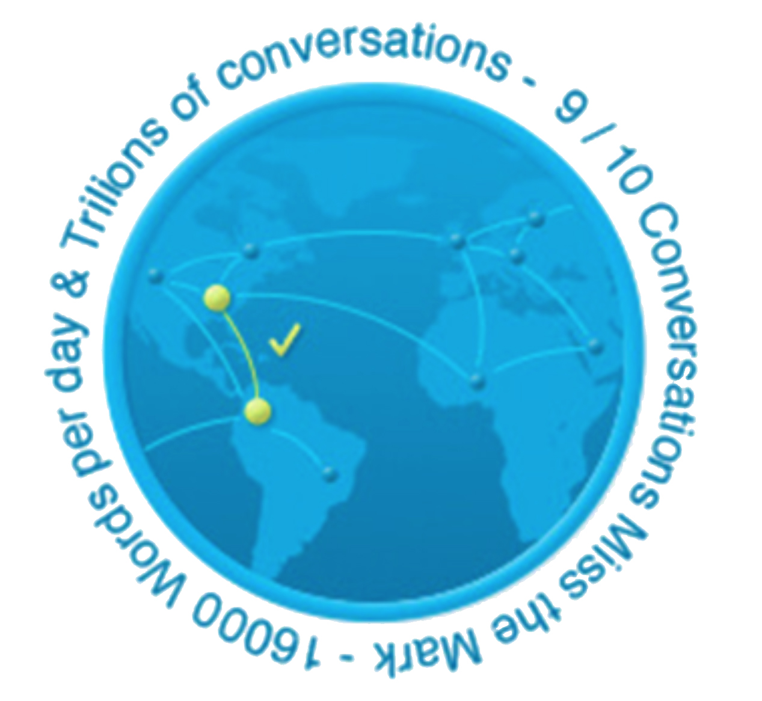
Your Words Create Your World
Is your world
I-centric or
We-centric?
© Benchmark Communications, Inc. / The CreatingWE ® Institute

Slide 4

What is Conversational Intelligence?
C-IQ is a replicable methodology to:
  Connect, navigate, grow with others
  Understand how conversations impact our relationships with others
  Activate parts of the brain triggering trust
  & innovation
  Initiate profound shifts in communication
  Increase impact & effectiveness
Judith E. Glaser
C-IQ makes the invisible visible

Slide 5
Objectives
Understand Essentials of Conversational IntelligenceTM
Experience the power of a C-IQ shift
Practice ways to improve the effectiveness of your work conversations
Practice key C-IQ principles

Slide 6
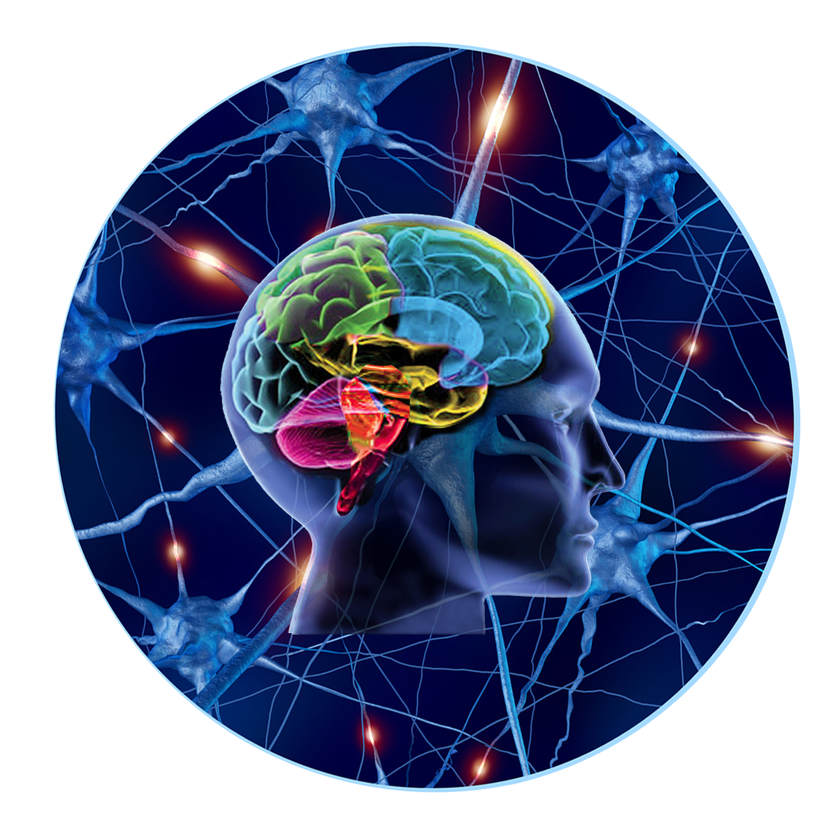
Chemistry of Conversations
Noradrenaline
Adrenaline
Cortisol
Oxytocin
Dopamine
Serotonin
GABA
Arousal & Stress
Connection, Pleasure & Calm
© Benchmark Communications, Inc. / The CreatingWE ® Institute

Slide 7
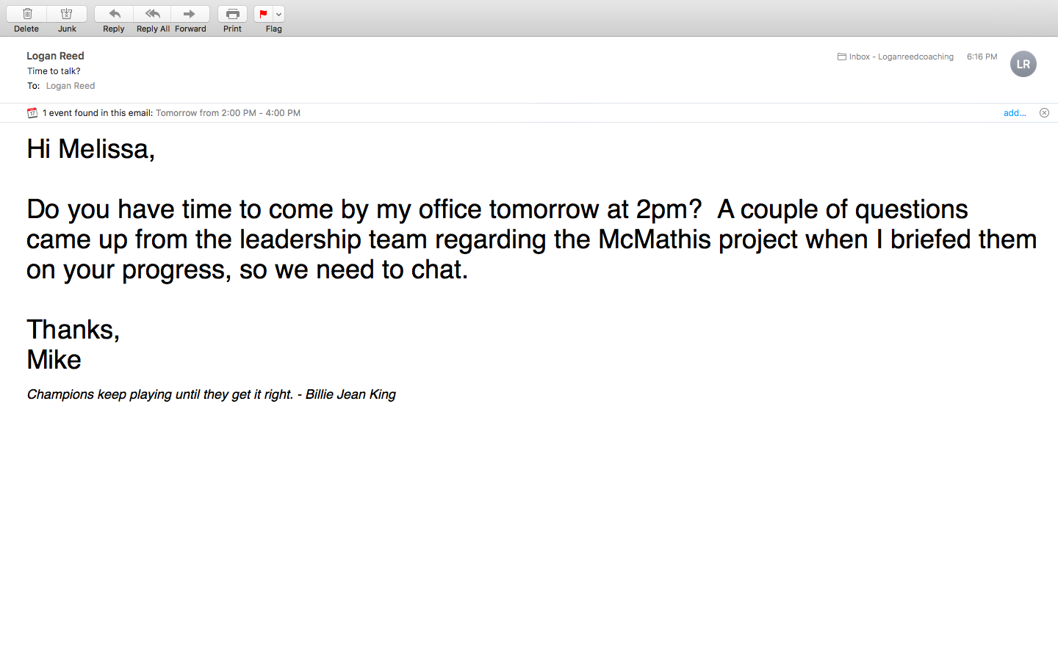

Slide 8
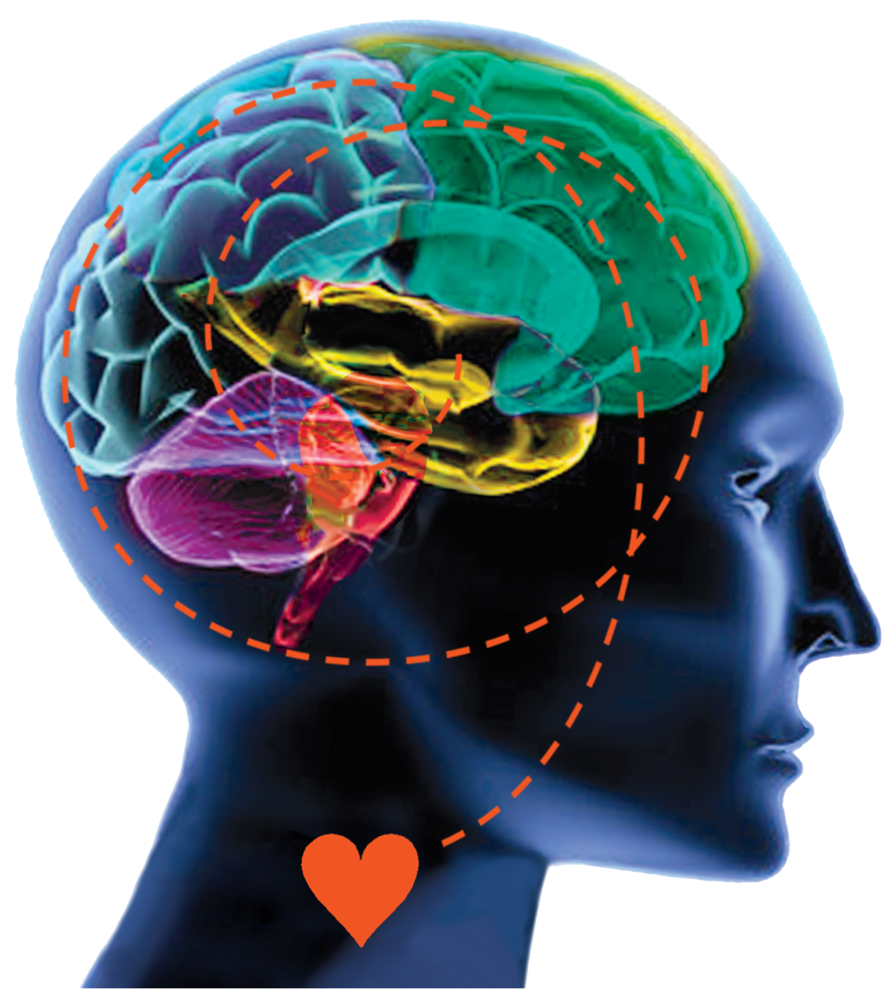

Where Fear & Trust Live In The Brain
Neocortex
Prefrontal
Cortex
Limbic
  TRUST
Primitive
Brain
  DISTRUST
Heart Brain
© Benchmark Communications, Inc. / The CreatingWE ® Institute
Notes:
Notes to Presenter:
Design Note: This image appears without any words and accompanies a 2-minute introduction to the brain anatomy as it relates to C-IQ.
The appearance of each word on the screen is triggered as the presenter speaks starting with the words in black, in order: “Amygdala,” “Limbic Brain,” “Neocortex,” and “Prefrontal Cortex”
Note: If the heart brain is picking up disappointment, distrust, etc., then the prefrontal cortex won’t open up. The heart is included in the symphony of the 5 brains working in concert.
Then “Trust” and arrow followed by “Distrust” and arrow.
Possible Speaking Points:
After a quick overview of the way the brain works, you’re going to be introduced to the 5 Conversational Essentials that will enable you to change your impact by changing your conversation.
The neurochemistry behind conversations enables us to quickly establish an environment of trust and connection – with individuals, teams and entire organizations.
Understanding and utilizing neuroscience of conversations enables us to achieve profound transformational results and revolutionize the way you interact as human beings.
Our conversations can reinforce trust or distrust.
If conversations go poorly, the amygdala can be activated and self-protective behaviors can emerge when we feel threatened. Distrust lies here.
When conversations go well, our pre-frontal cortex is activated and trust is increased.
An intentional conversation with intentional listening creates understanding and moves one from distrust to trust.
Connect back to previously discussed stories and/or exercise.

Slide 9

A Closer Look at Trust
Wha
What does trust feel like to you?
What does trust look like?
What does trust sound like?
How do you decide who to trust?
How do you know whether other people trust you?
When you trust someone (or a team), what is possible?

Slide 10
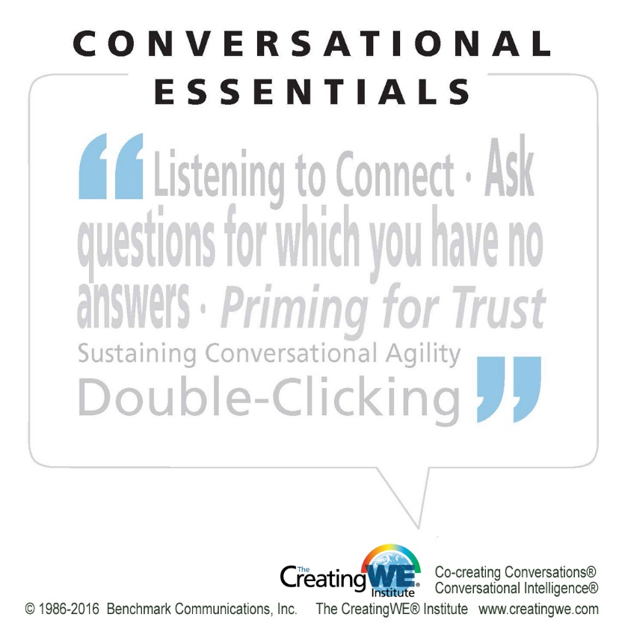
© Benchmark Communications, Inc. / The CreatingWE ® Institute

Slide 11





Listen to Connect
I’ve been
looking forward to hearing this….
Thou shalt not:
Reject
Accept
Confirm
Judge
Respond
Argue
Condemn
Approve
Tell me about that!
How did you learn that?

Slide 12

What if You Didn’t Have to Have the Answers?
Be inquisitive & curious
Activate trust networks in the brain
Expand the conversational
space
Open up access to the
prefrontal cortex

Slide 13
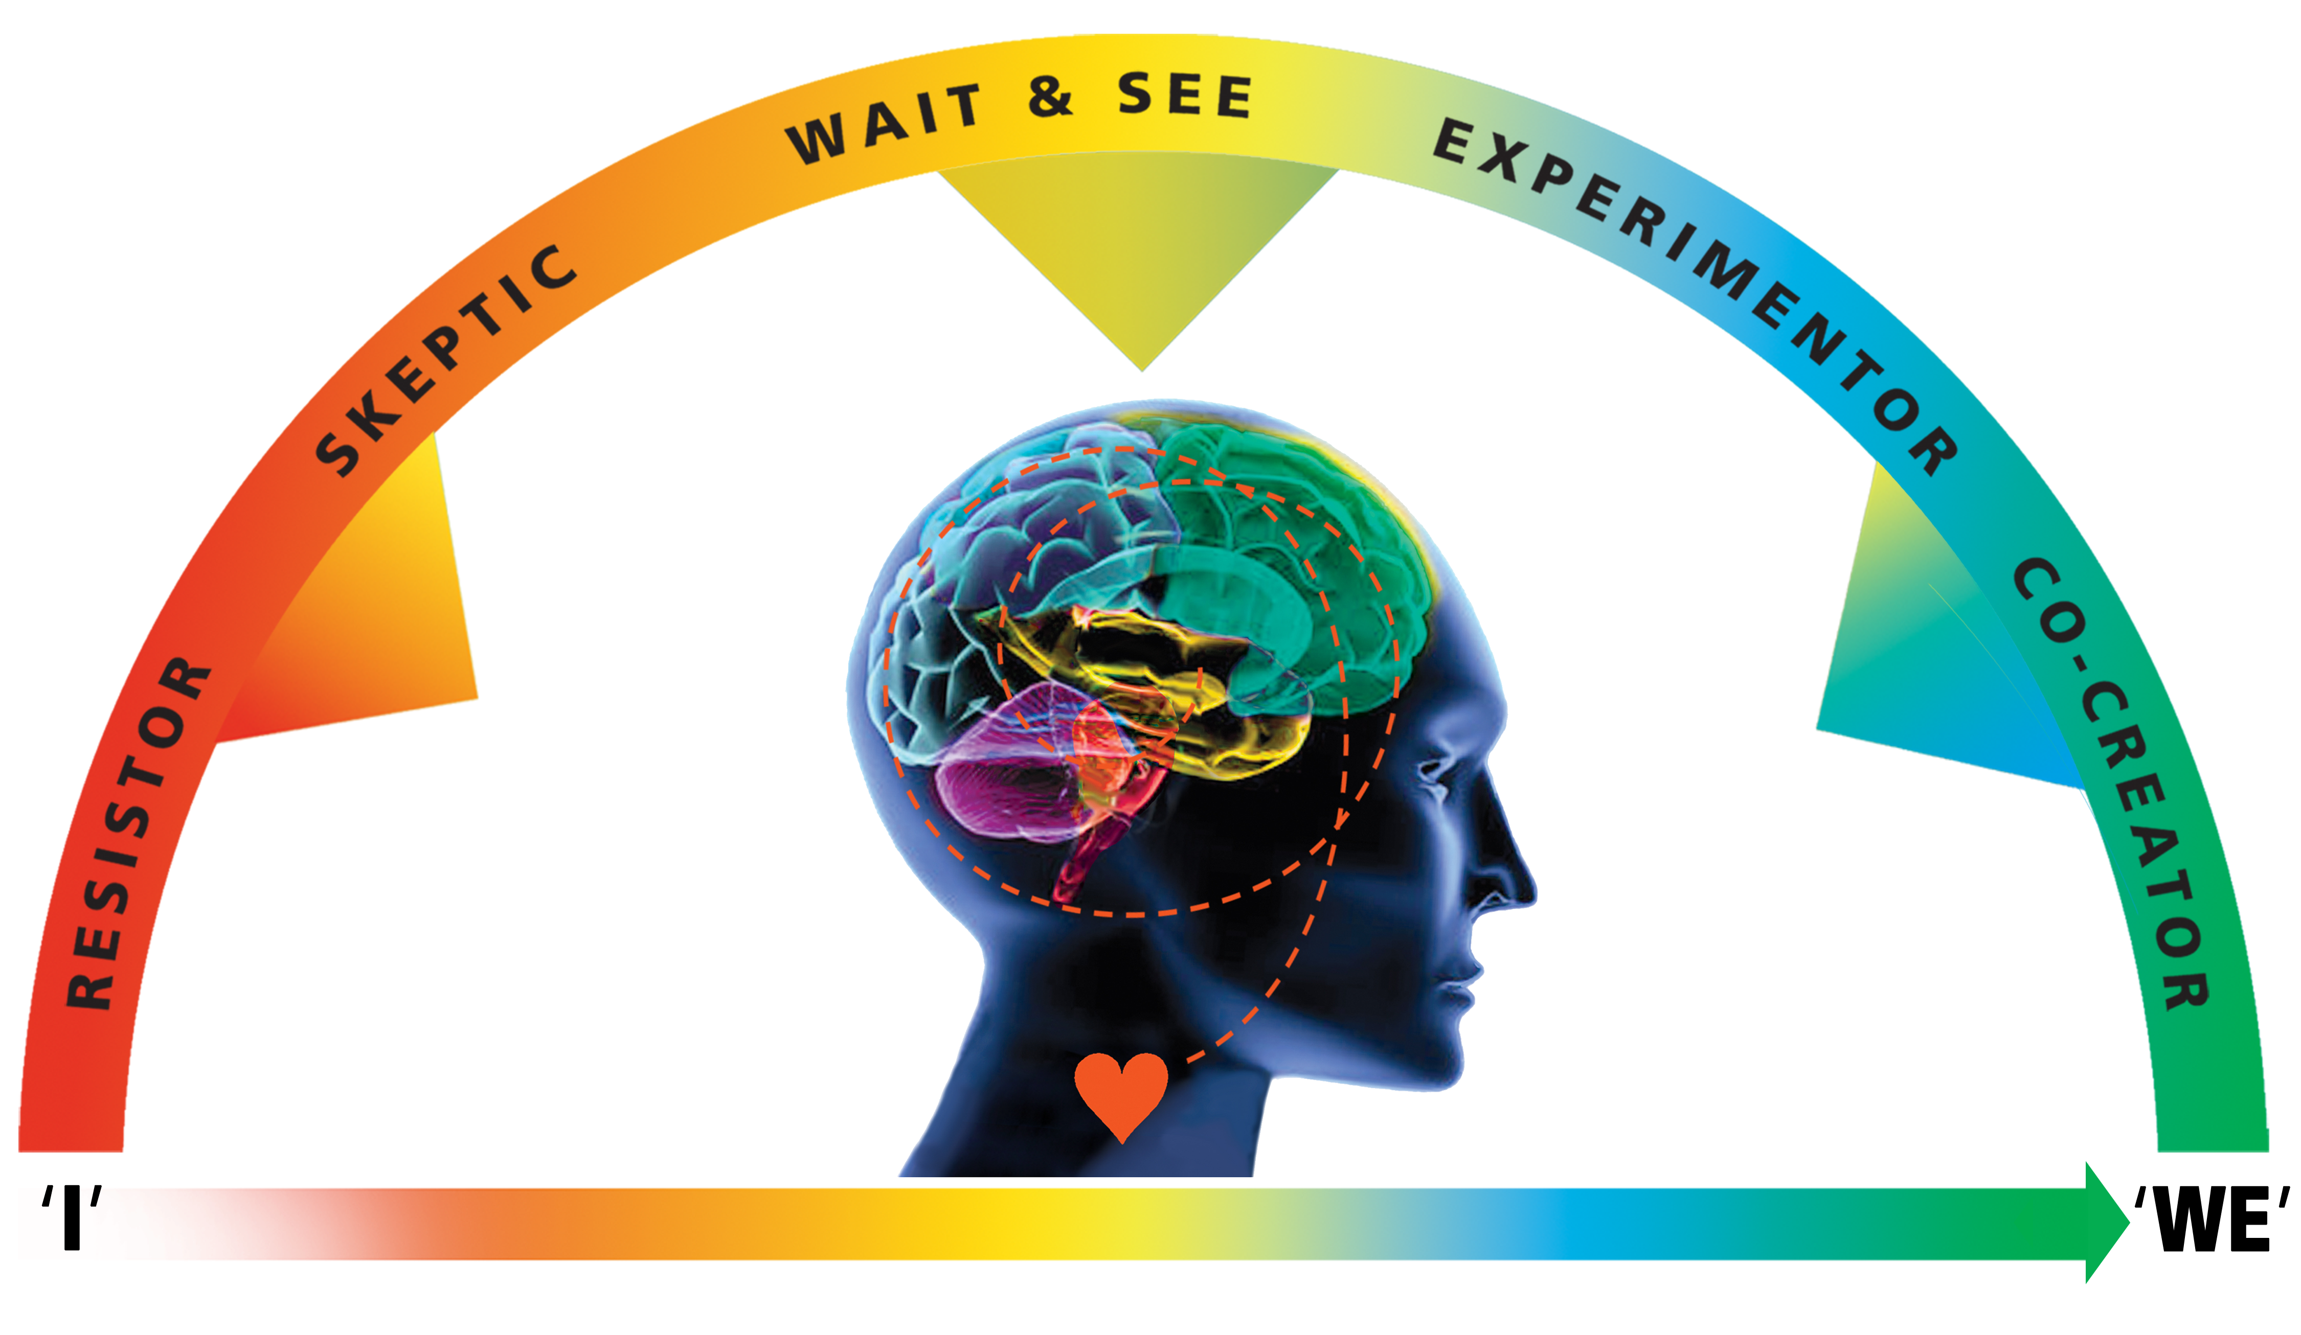
Where are you?
Conversational Dashboard
CONDITIONAL
TRUST
Neocortex
Prefrontal
Cortex
Limbic
LOW
TRUST
HIGH
TRUST
Primitive
Brain
Heart Brain
PROTECT
PARTNER
LISTENING
© Benchmark Communications, Inc. / The CreatingWE ® Institute

Slide 14
Nourishing/ Depleting Behaviors
Down-regulate (Cortisol)
Up-regulate (Oxytocin)
Include
Appreciate
Expand
Share
Discover
Develop
Celebrate
Exclude
Judge
Limit
Withhold
Know
Dictate
Criticize
DEPLETING
NOURISHING
© Benchmark Communications, Inc. / The CreatingWE ® Institute

Slide 15
Case Study: VP and Branch Manager
Branch Manager upset
VP went to her automatic (fixing)
Coaching intervention identified the gap (amygdala hijack)
Used Conversational Dashboard®
C-IQ Essentials: listen to connect, 3 Rs
Created win-win for Branch Manager and her team

Slide 16
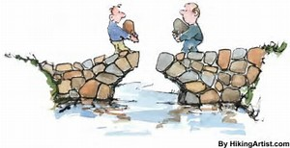
Discovery & Innovation Bridges the Divide
Intentionally creates the space to:
Rebuild and/or deepen trust
Re-open the channels of communication
Move the conversation/situation from “I” to “we”
You move towards them, rather than requiring them to move towards you
Sets the stage to explore new possibilities

Slide 17
Now You Try…
Sample Discovery Questions
Sample Innovation Questions
What assumptions do you
have about…?
Who else is impacted by this situation?
How does that make you feel?
What led you to this idea?
How would you describe…?
What is our best outcome?
What is your thinking behind
this idea?
What can we do to merge
our ideas?
What if we were to have no limitations, what would we do?
What alternatives would work?
What is your desired outcome?
What do we want to create?
How could we…?
What other experiences do you have with similar…?

Slide 18



Double-Clicking

Slide 19
Now It’s Your Turn
___
___
___
___
___
___
___
___
___
___
___
___

Slide 20
Invitation to Practice!
Pick one of the Conversational Essentials to practice for 1 week
Share the outcome with a buddy from this session and with me!

Slide 21
L.E.A.R.N. Exercise
L: What do you like most about today’s session?
E: What are you most excited to practice?
A: Is there anything that you want to ask?
R: What do you most want to retain from today?
N: What is next for you?

Slide 22
How to Reach Me
Logan@loganreedcoaching.com
360-529-1848
www.loganreedcoaching.com

