Slide 1
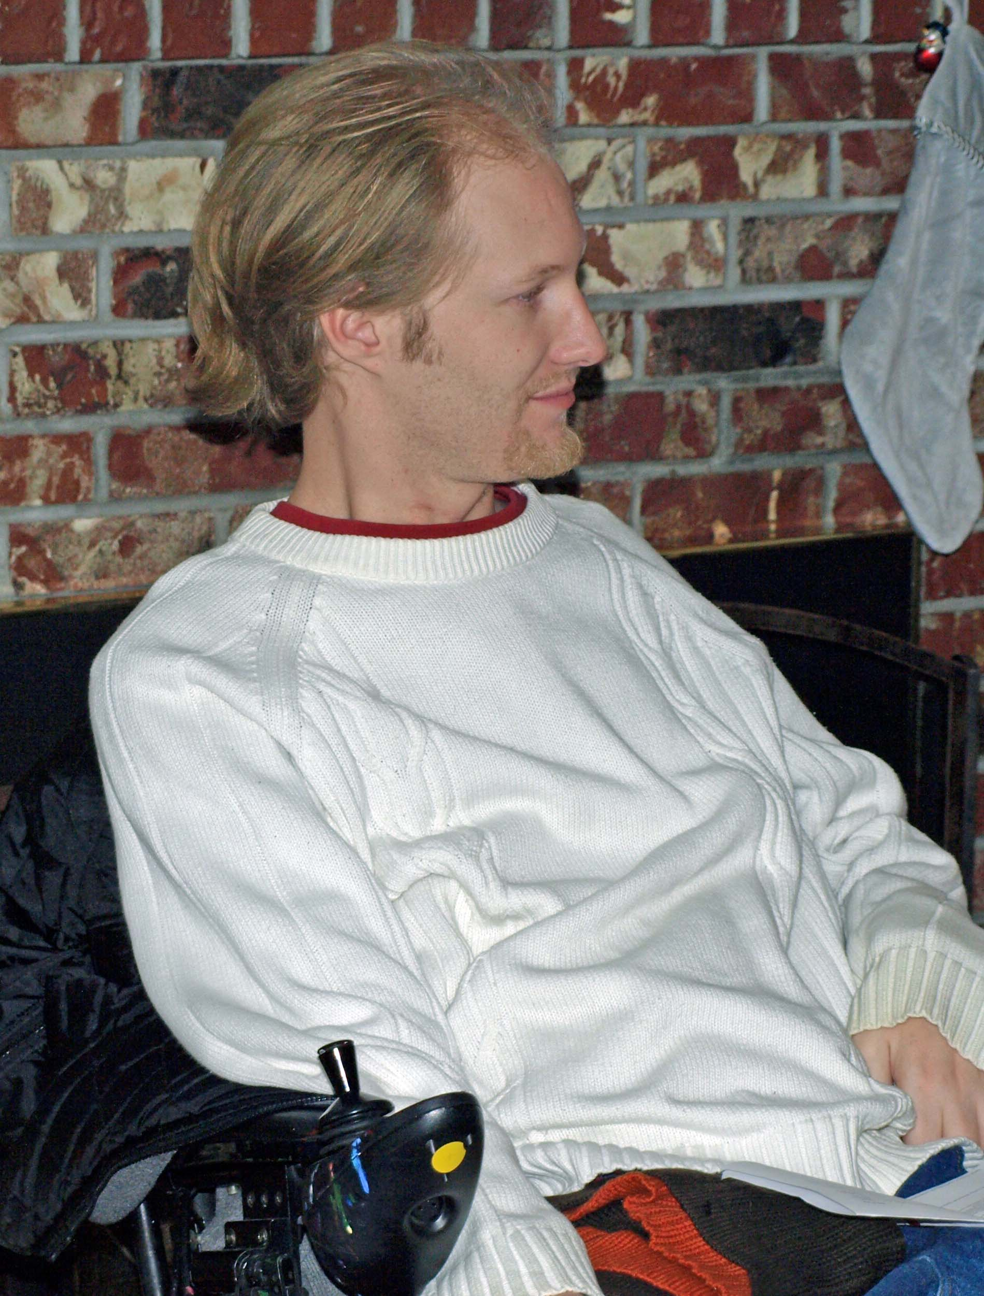
JOSHUA’S HOPE FUND
Better Living for Persons with Quadriplegia or Paraplegia

Slide 2
About Paraplegia / Quadriplegia (Tetraplegia)

Slide 3
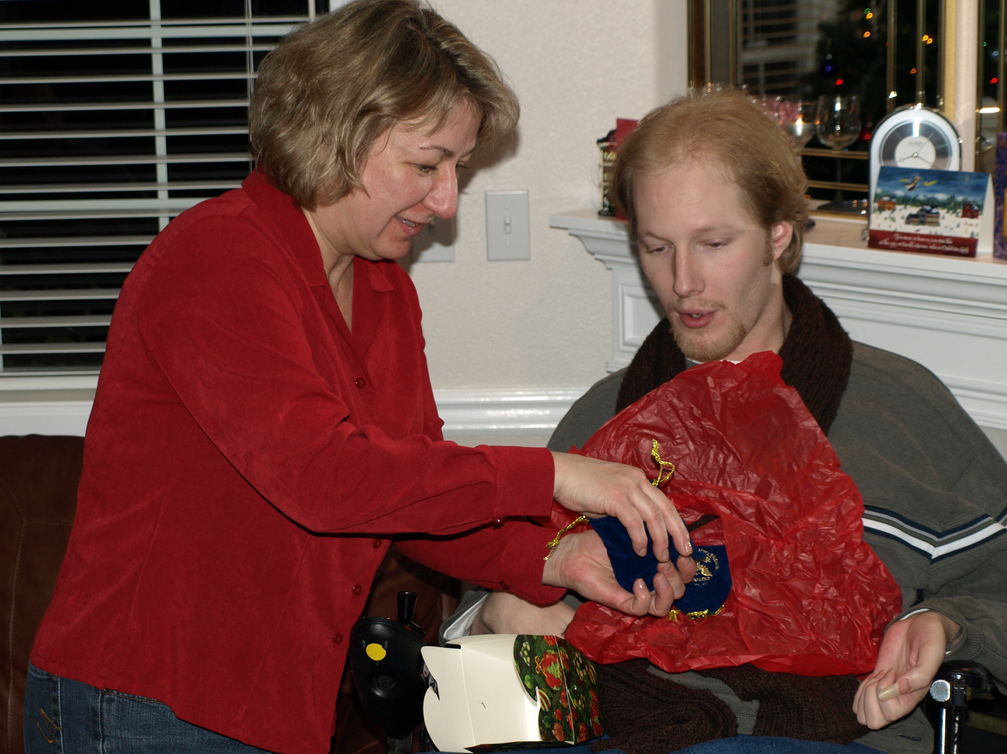
About Living with Quadriplegia
Extent of limitations dependent on level
Mobility limitations
Affects body functions we take for granted
Temperature Control
Elimination Functions
Susceptibility to illness
Forced dependency on others
The battle with depression

Slide 4
Who we are:
JOSHUA’S HOPE FUND
Joshua’s Hope Fund is raising funds to assist young adults living with paraplegia or quadriplegia.
Incorporated as the Joshua’s Hope Fund on June 6, 2006
Dormant until non-profit status was obtained in August of 2015
Our initial goal was to provide assistance with activity support, housing and transportation needs for those living in the South Puget Sound area. We launched our fund raising effort on August 1, 2015.
Our long term goal is to build an apartment complex that incorporates the special resources needed by people who live each day with paralysis. We want to construct a facility and make available support services that will help at least 24 people live a more rewarding, productive and fulfilled life.

Slide 5
How we are different:
Many organizations exist for assisting persons afflicted with paraplegia and quadriplegia. They focus on:
Research regarding treatment and cure
Physical and vocational rehabilitation
Providing one time or short term assistance to purchase needed goods and/or services
Mobility Devices and Special Equipment
Medical Appliances
Transportation
Housing Modification
Joshua’s Hope Fund goal is to provide an integrated support system for person’s afflicted with paraplegia and quadriplegia beginning with stable, secure housing.

Slide 6
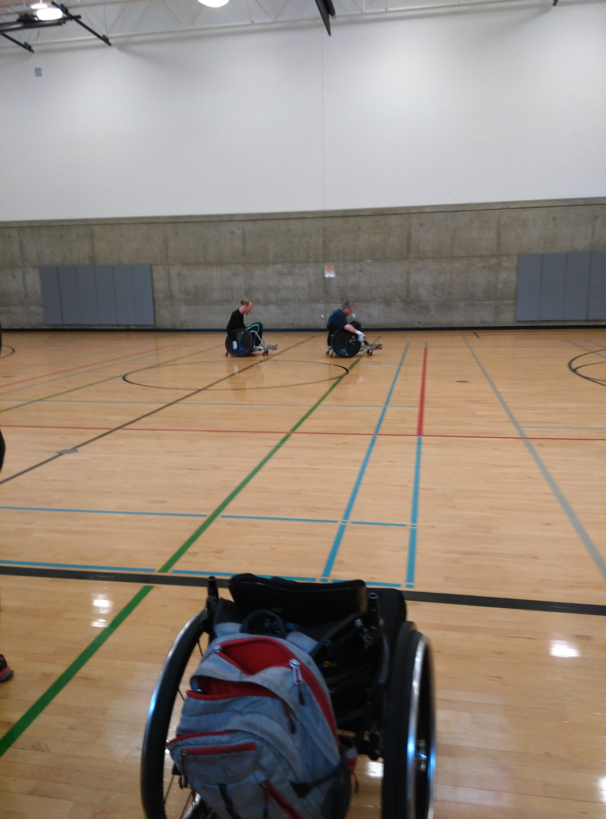
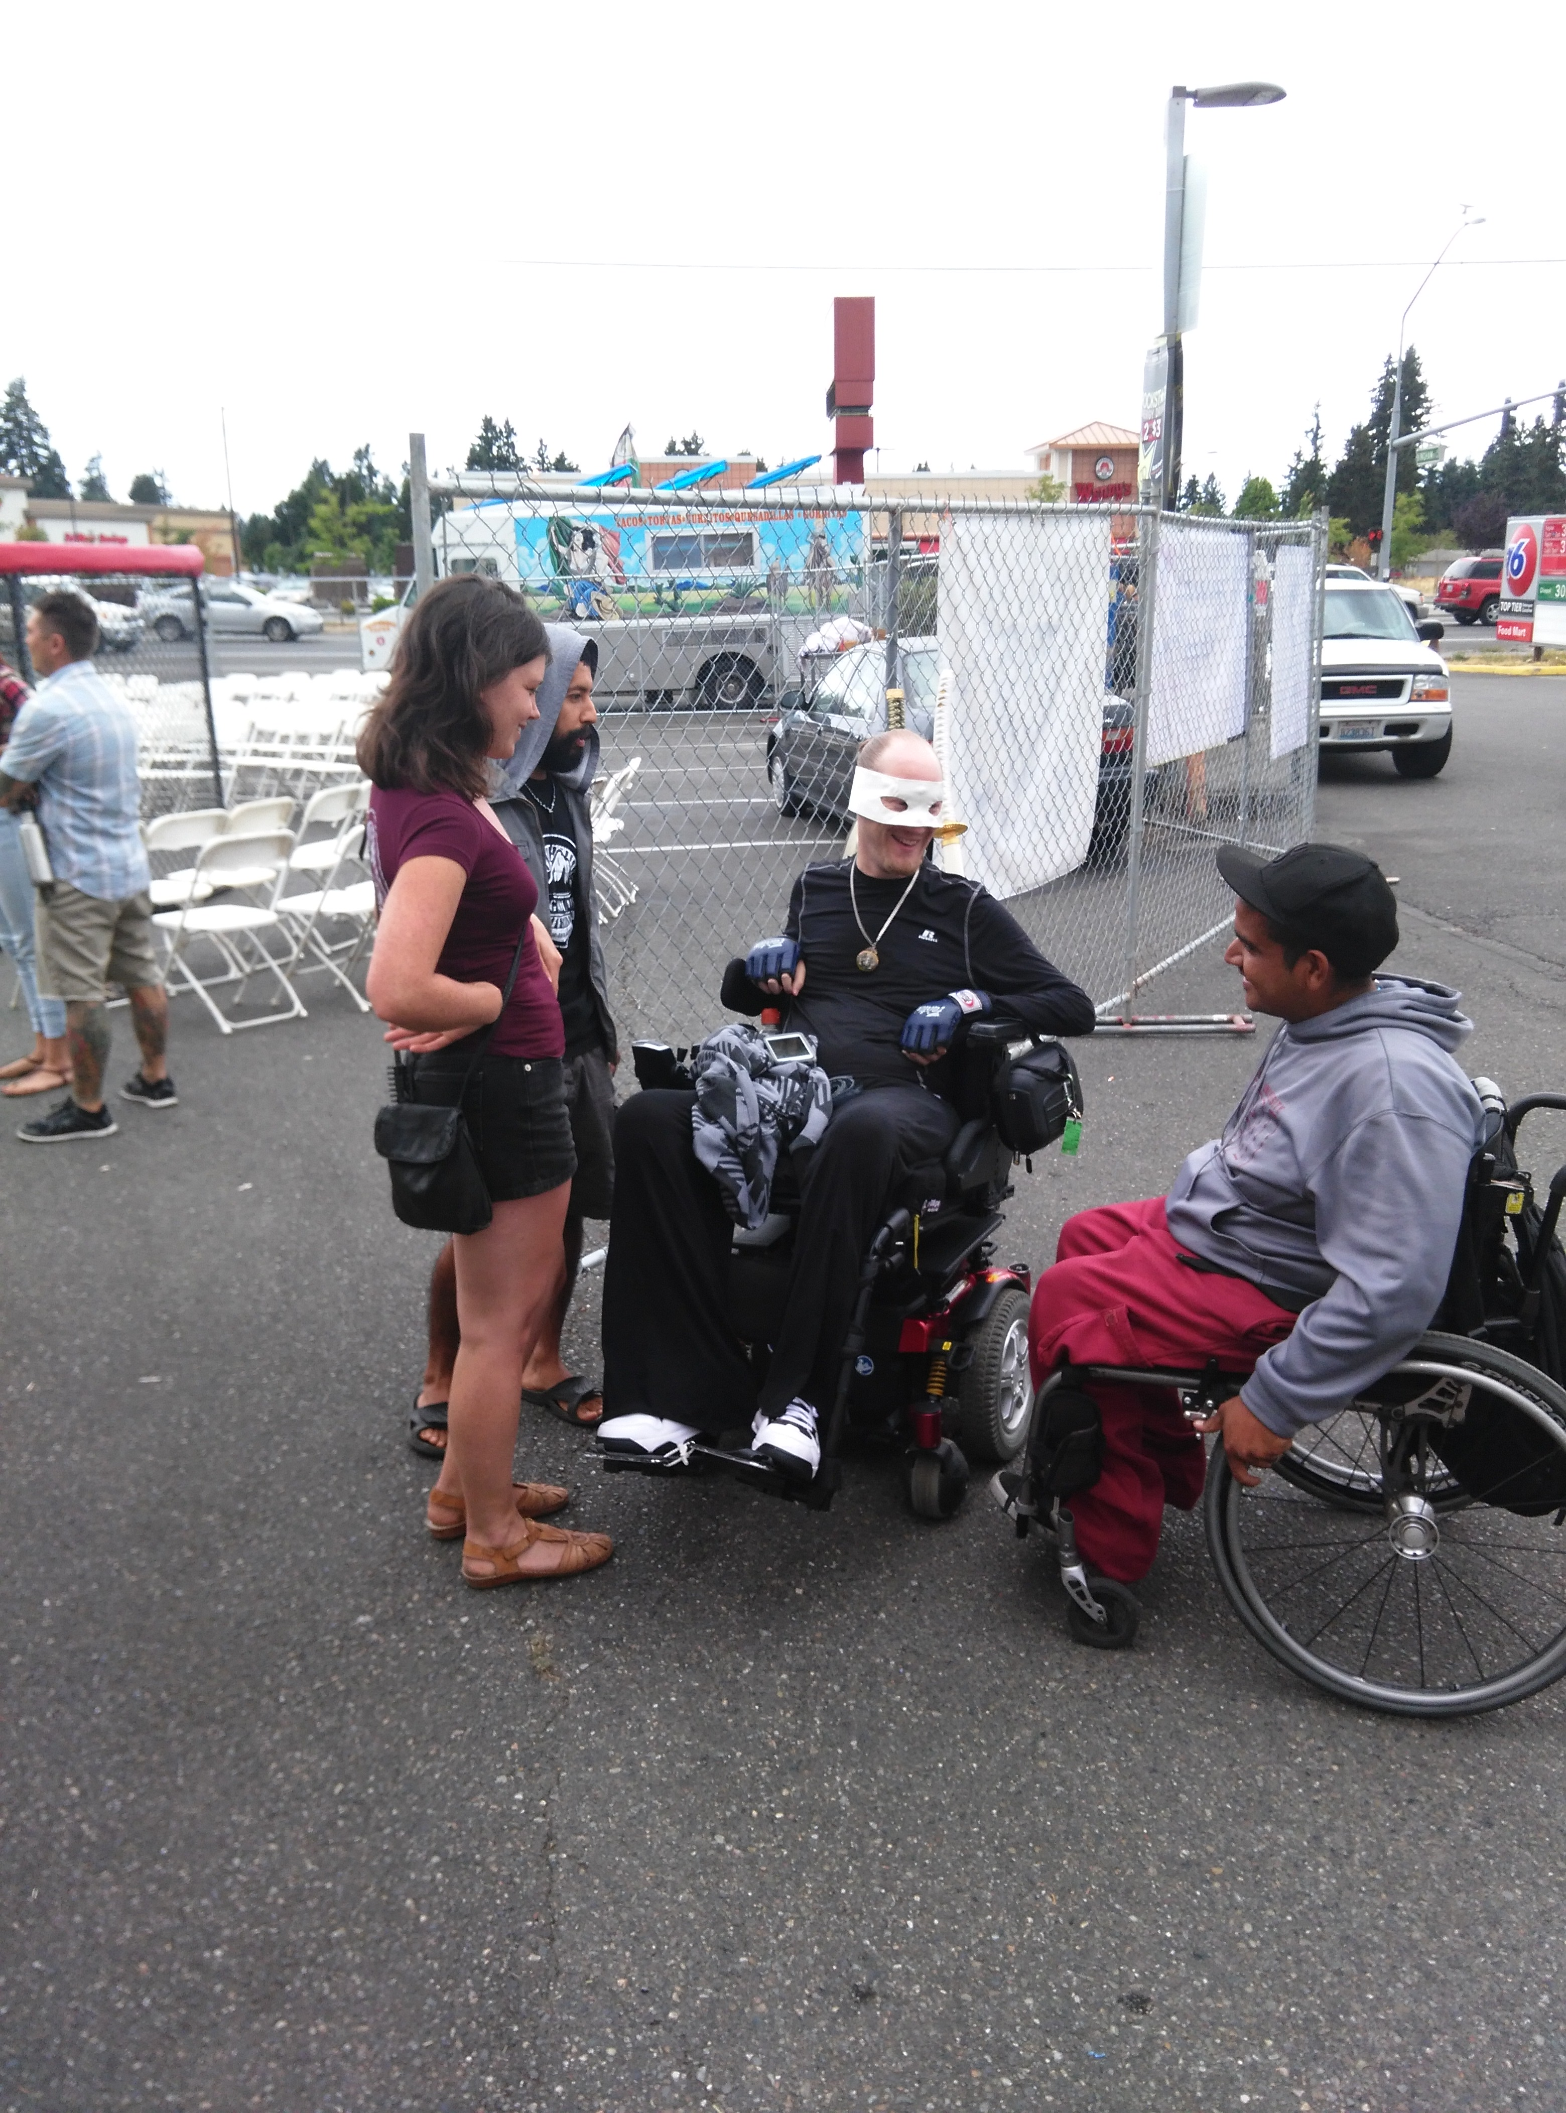
What we have done
Assisted with rent support
Assisted with power bills
Assisted with transportation
Provided adjustable beds

Slide 7
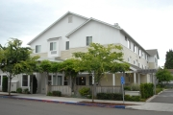
What we want to do
Build an apartment complex specifically designed for the needs of quadriplegic an paraplegic persons
Provide support to train and place care givers capable and willing to work with quadriplegic and paraplegic persons
Provide the support needed to improve physical and mental well being
Provide education and employment opportunities

Slide 8
How you can help
Volunteer your services
Serve on our Board
Professional services
Architectural
Marketing
Fund Raising
Grant Writing
Medical
Give money
Spread the word

